Slide 1
Capitalism and Class Structure
Christian Beane and Peter Howarth

Slide 2
https://neal.fun/printing-money/

Slide 3
The Gap Between the Upper and Lower Class
Near the year 2000, the productivity of companies started to skyrocket compared to the past few years, but not everyone benefited from this surge.
From 2000-2006, income distribution only rose 1% for the middle class, compared to the 6% increase from 1995-2000.
With many jobs going abroad, companies were able to spend less on labor while maintaining their profits.
Instead of the rich get richer and the poor get poorer, the middle and lower classes maintain somewhat of a status quo while the rich continue to get richer.

Slide 4
Share of aggregate income in 1980 and 2004
essentially the anti-Robin Hood, in which the rich get richer
The top 1%
1980: 8%
2004: 16%
The top 0.1%
1980: 2%
2004: 7%
The top 14,000
1980: 0.65%
2004: 2.87%

Slide 5
What about other gaps?
source

Slide 6
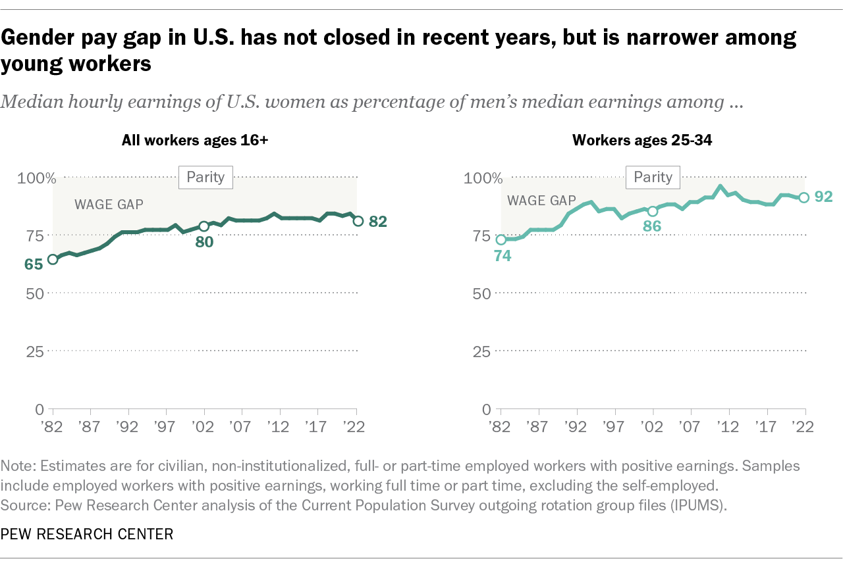
source

Slide 7
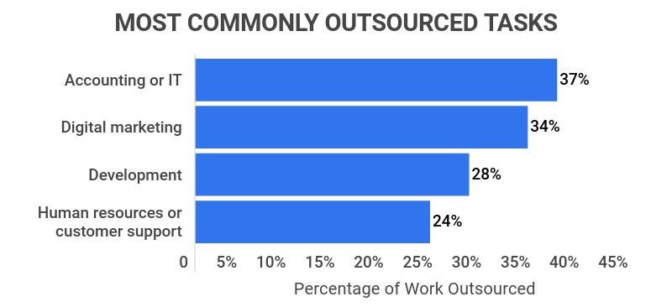
The Role of Technology and Offshoring
Technology eliminates simple jobs that can be computerized
Offshoring takes away jobs that can be minimized down to following a script or rules
In both cases, companies pay their workers less, all while maintaining their income.

Slide 8
Nickel and Dimed
Journalist, Barbara Ehrenreich went undercover in three American cities
Key West, Florida; Portland, Maine and Minneapolis, Minnesota
Worked minimum-wage jobs in each city
Learned about the everyday sacrifices and decisions those in poverty have to make
Paying more to live closer to work or saving money by commuting farther
Selling your car to commute by bike or public transit

Slide 9
Key Takeaways
Employers will offer many free “benefits” – merchandise discounts, free food, travel stipends – rather than raises as they’re easier to take away
The “money taboo” discourages workers from sharing salary information, restricting mobility in the job market
Workplace authoritarianism also keeps morale low, making workers believe they have little self-worth

Slide 10
Similar Problems Faced Today
In 1999, the federal minimum wage was $5.15
Today, the federal minimum wage is $7.25
$5.15 calculated for inflation to 2023 is worth, $9.42.
The raise in minimum wage has not properly reflected the rise of inflation.
According to Forbes, the average monthly rent is $1,372
Working 40 hours a week at a minimum wage of $7.25 would earn you $1,260 monthly pre tax
With this math, someone working a minimum wage job would not be able to afford rent, not even taking into consideration the cost for utilities, food or transportation

Slide 11
Media Representations of Poverty
The caricaturing of class for desired outcomes:
Comedy: The Simple Life
Commercial gain: Jeff Foxworthy
Portrayals of why those are in poverty situations
Usually self-inflicted: drug use, alcoholism, criminal activity
Doesn’t show: poor city/state infrastructure, degradation of welfare programs, and many of the day-to-day choices detailed by Ehrenreich
Focusing instead on the (desirable) middle class
That’s where the money is!

Slide 12
www.playspent.org

