Slide 1
Capitalism
By: Lily and Golibe

Slide 2
What is Capitalism
Kids definition: Capitalism is an economic system. Meaning, it is a system for dealing with money and wealth. In a capitalist country, citizens, not governments, own and run companies. These companies compete with other companies for business. They decide which goods and services to provide. They also decide how much to charge for the goods and services and where to sell them. Companies do all these things to make money for their owners. People who use their money to start or to run companies are called capitalists.
Notes:
Lily: look at my notes I made on my word doc
Golibe: Talk about Derivatives and Futures

Slide 3
East Indiaman
Back in 1601 the first successful venture was made by the English East India company with its 4 ships Ascension, Dragon, Hector, and Susan with a cargo mainly of pepper.
PROFIT
THE RESULT OF
SCARCITY & DISTANCE
Notes:
Note about profit - come back

Slide 4
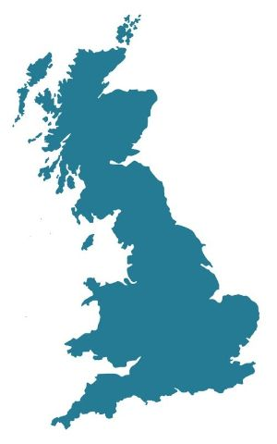
Where did Capitalism come from?
Why Britain? It was the first industrial society. The breakthrough of capitalism in the 18th century helped the success of it in the 19th century.
Why Europe? It has a multi-state political structure and it lies in feudalism itself.
Multi-state political structure is a political system in which multiple political parties across the political spectrum run for national elections.
Feudalism= Power and Wealth
GREAT BRITAIN
Notes:
Feudalism(lily): Feudalism was a system in which people were given land and protection by people of higher rank, and worked and fought for them in return.

Slide 5
How did we get here?
Anarchic capitalism: This was a stage in the 18th and early 19th centuries when industrial capitalism made its breakthrough
Managed capitalism: During the next stage in the development of capitalism, which began in the second half of the 19th century and came to its peak in the 1970s, competition and market regulation declined as both sides of industry became more organized and as state management and control increased
Remarketized capitalism: In the 1960s the welfare state, corporatist relationships between governments and major interest organizations, and extensive public ownership all appeared to be well-established features of British society.The real problem was that increasing international competition was putting the old industrial societies under growing pressure
Notes:
LILY

Slide 6
Transformations of Capitalism
First transformation:
From Anarchic to Managed capitalism showed that it was possible to protect people from some of the worst consequences of the market force.
The problem with this made it weaken the central mechanism of a capitalist economy
Second transformation:
Market forces were revived, however, because of the no ‘rolling back’ of the state operations were limited.
The new world of remarketized capitalism creates more room for freedom for the individual but also intensified work pressures and greater inequality.
Notes:
First transformation problem - was that in restricting and replacing the market provision of the goods and services it was weakening the central mechanism of a capitalist economy. Second transformation - the no rolling back state for market mechanisms could only operate in the context of state intervention and regulation.

Slide 7
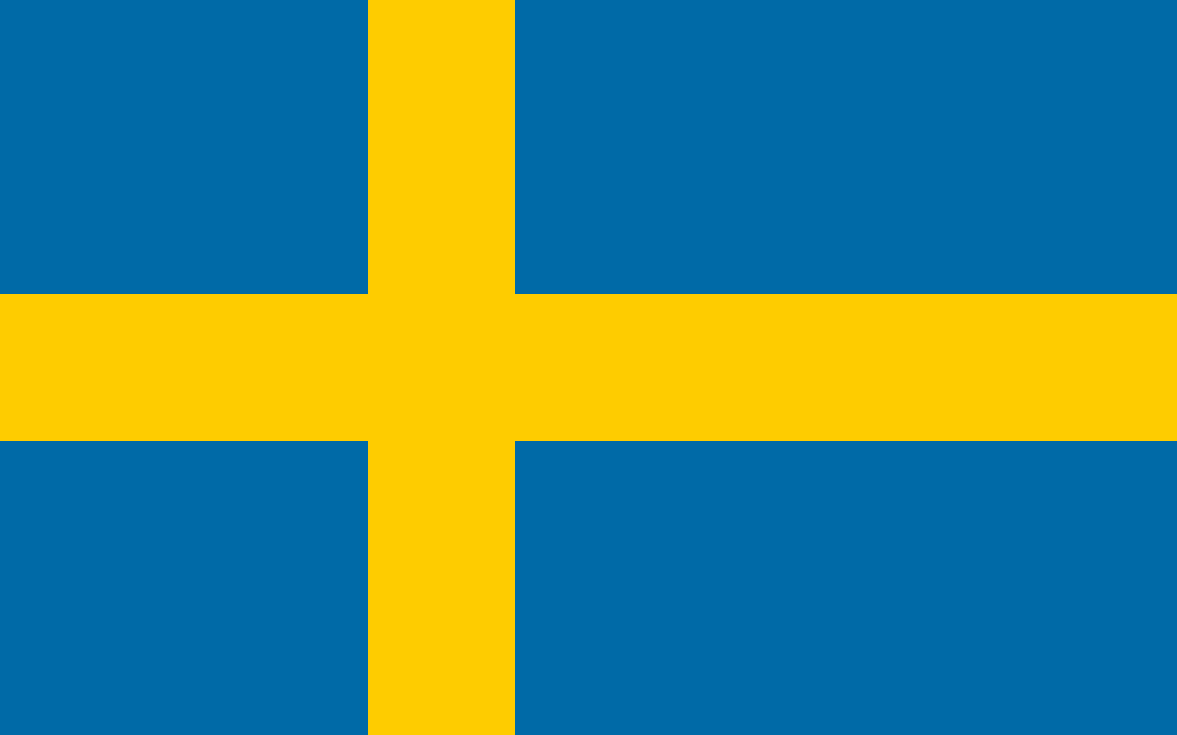
Is Capitalism the same everywhere?
Sweden Capitalism
Intense class conflict during the early years of industrial capitalism
When their politics moved in a neo-liberal direction caused a few issues
It was small domestic market because of its population
A strong and unified labour movement also provided the basis for a long period of social democratic government
American Capitalism
Was the home of the ‘managerial revolution’ theory
The intensified exploitation of labour and the emphasis on shareholder value raised corporate profits
They had a large domestic market with enable the growth of big corporations
Current state of capitalism reflects its historic distinctiveness
Japanese Capitalism
By the 19th century it was a highly commercialize and entrepreneurial society
Was the only non-western society to industrialize successfully
Started to grow but the growth caused issues and lots of criticism
Union organizations grew rapidly
They all created convergence
Notes:
LILY

Slide 8
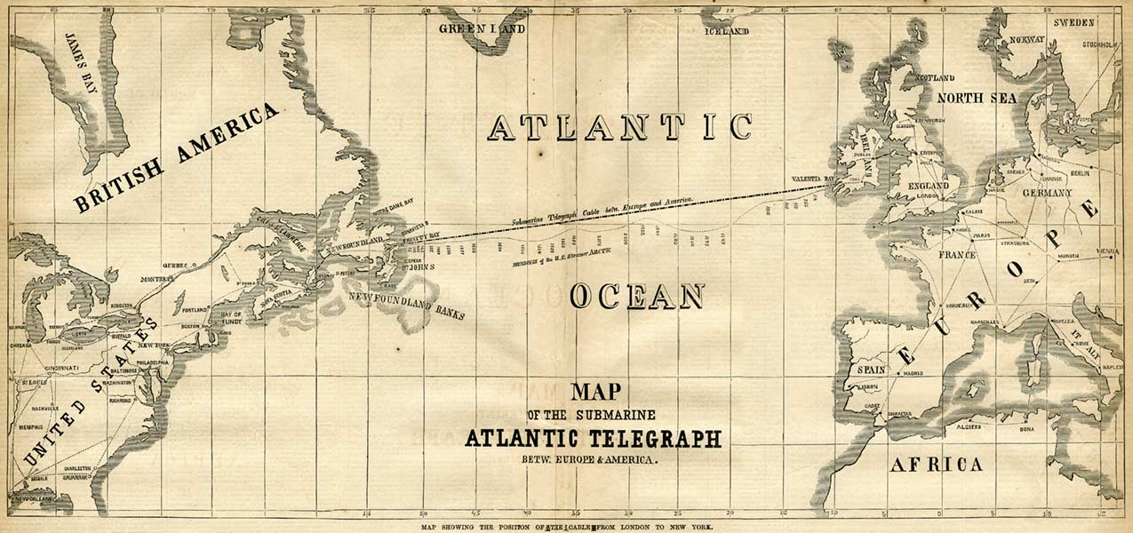
Global Capitalism
Telephone & Telegraph:
Travel was slow so the invention of the telegraph meant messages not sent via people or pigeons.
Then the telephone ‘destroyed distance’ with its instant communication.
Myths:
That global capitalism is something new
That capital circulates globally, when in reality it travels between a small group of rich countries
Capitalism is now organized globally rather than nationally
Notes:
One global aspect is the telework -

Slide 9
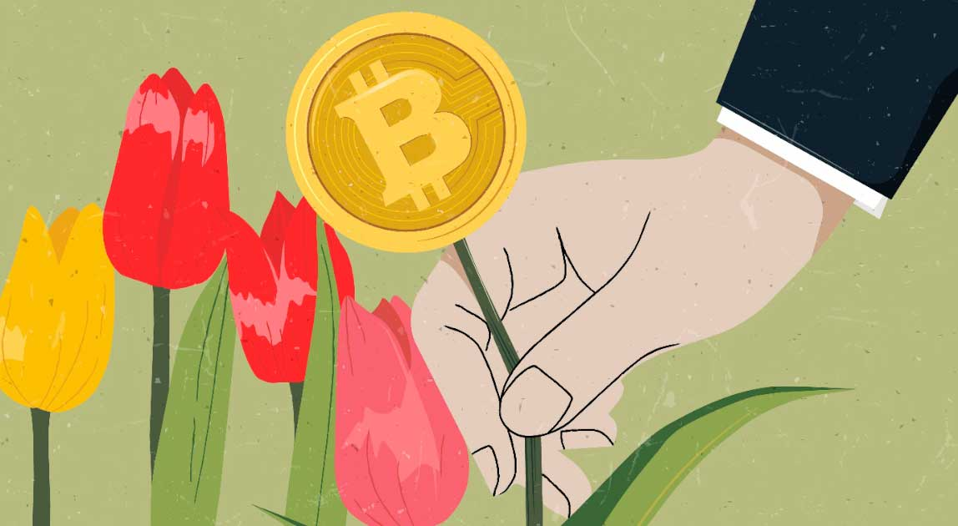
Crisis
The Tulip Bubble in 17th-century Amsterdam
More exotic and rarer specimens had become highly prized
High demand resulted in rapidly rising prices which led to a collapse
The high demand for bulbs led to rapid changes in the bulb trade
Trading in futures was the central mechanism in the inflation of this bubble which was an established practice
Crisis of the 19th century
The bursting of the tulip bubble did not impact significantly on the economy as a whole but the growth of capitalist production did
Overproducing was built into capitalist production
Karl Max argued that capitalism was prone to crisis because production was separated from consumption.
The Great Depression in the 1930s
The ending of the First World War left the economy in a fragile state leaving the world to be in debt
Production declined in the industrial world which resulted high unemployment and a drop in demand

Slide 10
Please bring out your phones and get ready to scan the barcode and enter the pin. Time to test your knowledge. https://create.kahoot.it/details/22a07b93-7452-4e1c-b87c-de80b3689d01

