Slide 1
Understanding Capitalism
By Zack Collura and Jake Mendel
Notes:
Sorry I am just going to throw everything down here and then we can put everything together on Saturday
Capitalism is essentially the investment of money in the expectation of making money (2) Basically only the rich- “Expectation” is an interesting word, which means that there is potential to lose money. Rich people started to hedge their bets as we learned later on.
Capitalism was by the rich, controlled by the rich, for the rich, ran by the poor (2) “The Company’s privileges depended on royal favor” (3)
“Risk was reduced by monopolistic practices like buying up stock and holding back sales” (3)
By holding stock the companies could raise prices but also destroy opposing companies by flooding the market (4)
Labor forces grew 5 times in 30 years (5) we could look at what people were doing before/ overall wage went up only 10,000 euros because of cheap/ unskilled labor
While wages didn't go up much, leisure was created from long work days and workers reaching their breaking point. Leisure created more industries that fed back into capitalism
Corporate hunger led to horrible deals (12)
Wage labour/wage slaves (14)
Money is bought and sold(15)
Competition makes capitalist production exceptionally dynamic(15)
Price changes allow people to make money through speculation (16)
Conflict between the employing and laboring class (22)
Economic destruction created by warfare(30) this is interesting because in the modern day war=good economy
ONly Unions that could survive are skilled workers(39)
Employers came together (41)
British state took responsibility for people’s welfare (44)
No control over market because of international trade (48)

Slide 2
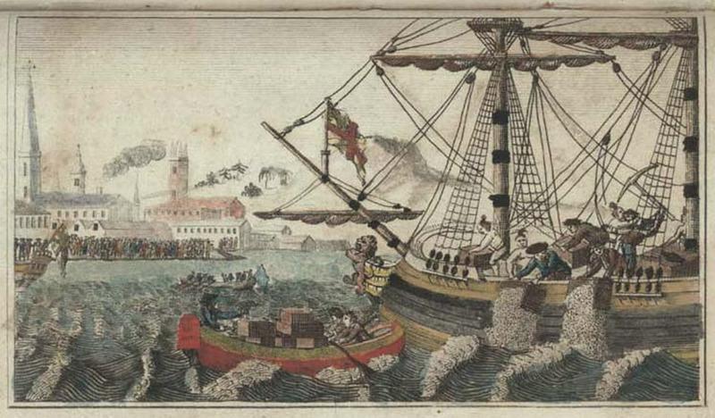
What is Capitalism?
Capitalism is essentially the investment of money in the expectation of making money (2).
While profit-seeking and trade existed for hundreds of years, in the 17th and 18th century, capitalism emerged as a system out of mercantilism in Europe.

Slide 3
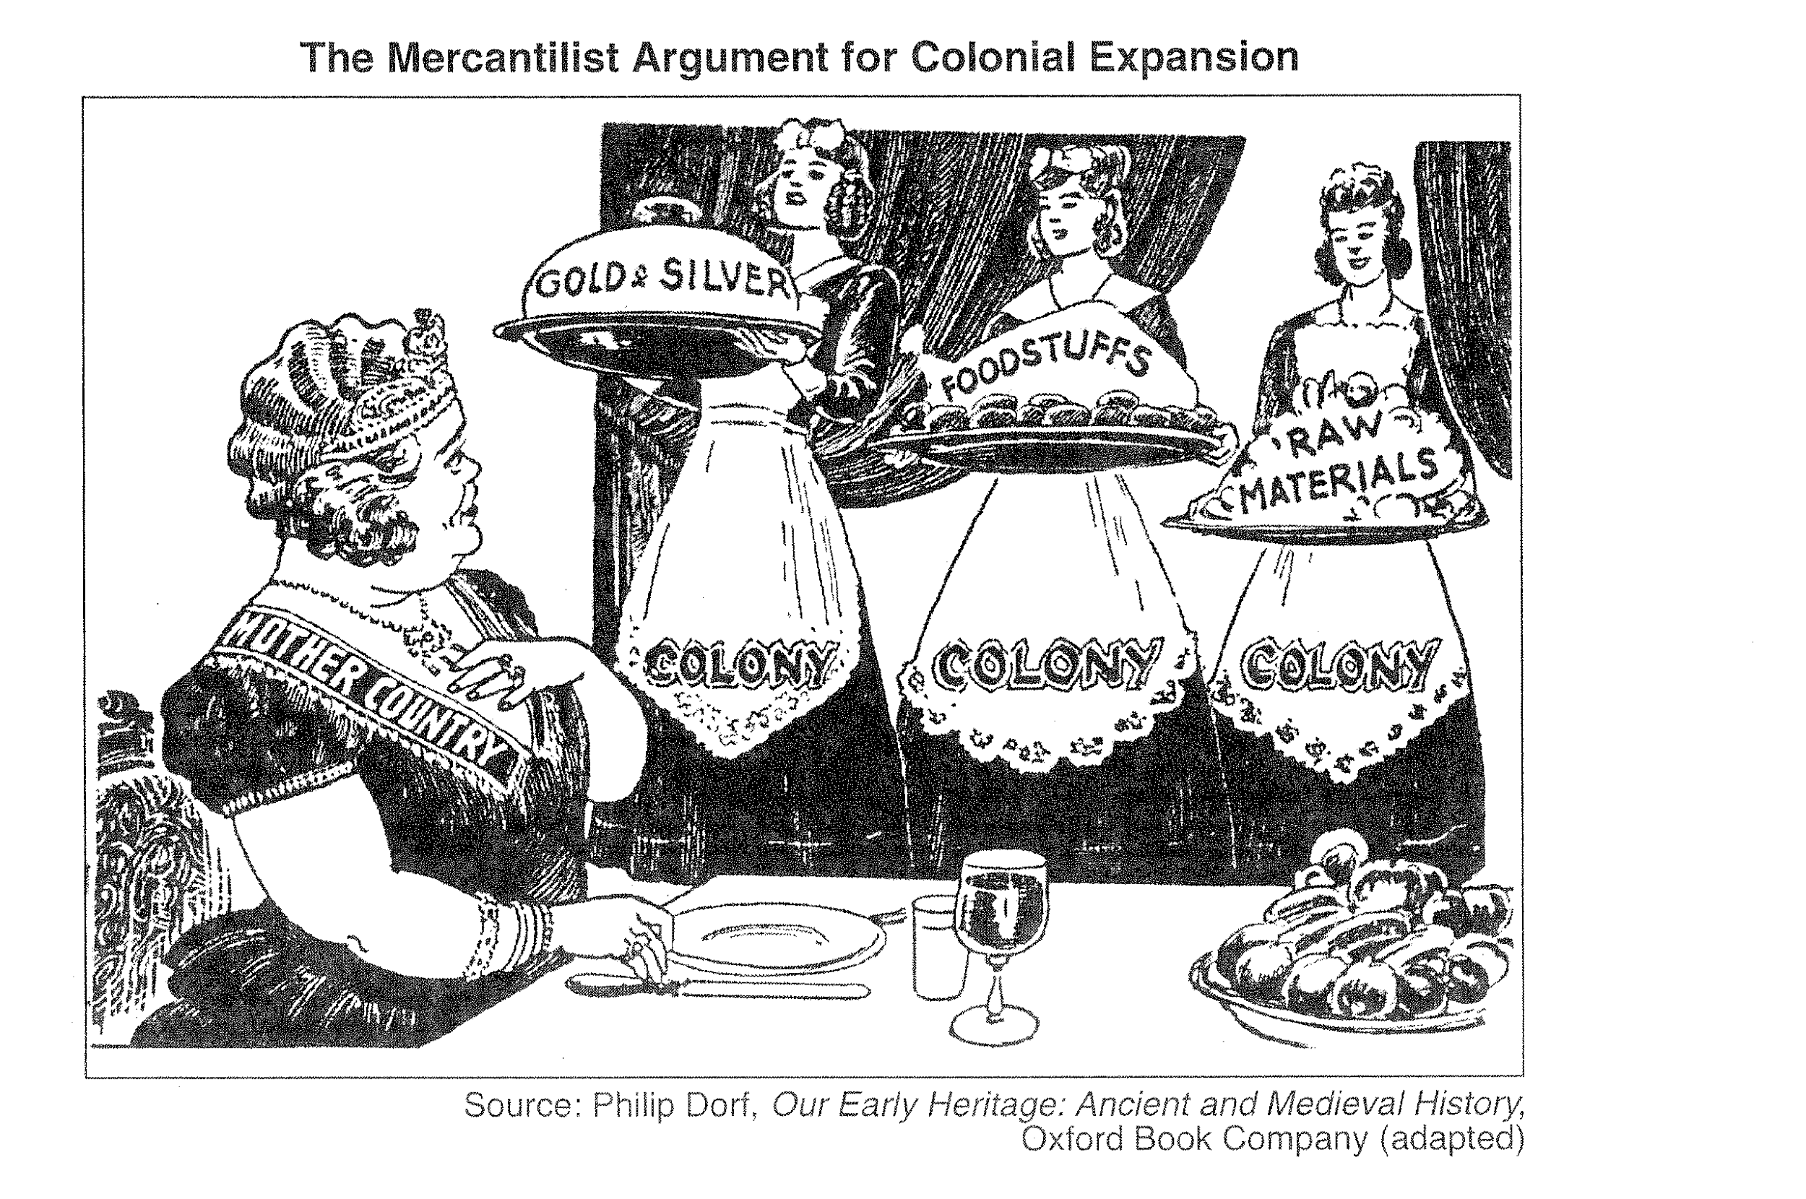
Mercantilism and the Origins of Capitalism
Mercantilism revolves around trade. The core of mercantilism is the simple practice of selling something for more than you paid for it. It's based on the concept of profit.
Mercantilist countries wanted to export as much as possible and import as little as possible.
Notes:
The History of Trading
Term Paper, 2004
17 Pages, Grade: 2,0
Adam Smith argued that trading

Slide 4
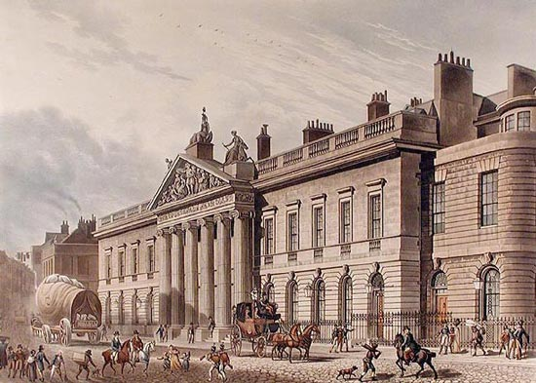
East India Trade Company
One of the first examples of capitalism is the the growth of the East India Company.
People were gaining wealth from mercantilism, and there was an understanding that “huge profits could be made at some considerable risk by long-distance trading ventures.”
The East India House in Leadenhall Street, London, drawing by Thomas Hosmer Shepherd, c. 1817.
Notes:
If something like pottery clay or wheat were abundant locally but scarce in a distant town, merchants brought those goods to towns where they could fetch a higher price. This type of economic mobility was possible because of the relative peace and order of these well-developed societies.
“The first twelve voyages were each financed seperately, with capital committed to one voyage only and the profits of the voyage distributed among the shareholders…This was, however, a risky way of financing long-distance trade, for it exposed capital to a long period of uncertainty in far-away and unknown places…whole expeditions could, nonetheless, be lost” (3).
“The company shifted to a method of finance that spread risks over a number of voyages and then became a fully fledged joint-stock company, with, after 1657, continuous investment unrelated to specific voyages. In 1668 trading in its stocks began on the London Stock Exchange” (3).

Slide 5
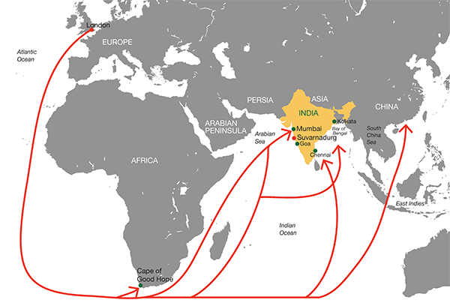
East India Company
The first two voyages to the East Indies made the company a profit of 95%.
The cargo they returned was scarce in Europe, and the profit made from it “dwarfed the costs of the venture.” The fourth voyage, however, was lost.
Notes:
The 4th voyage was lost, and the investors lost their capital.

Slide 6
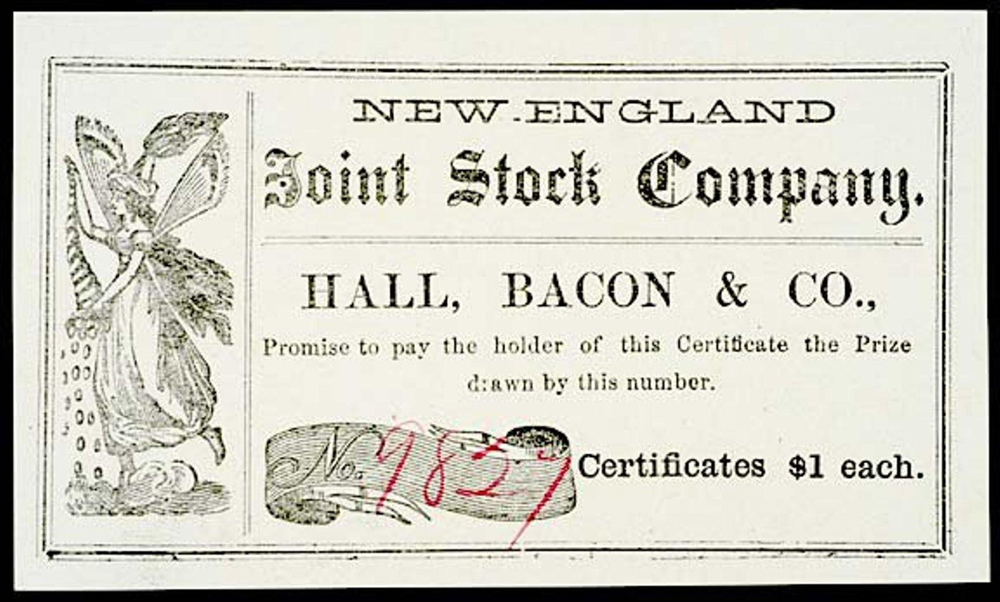
Joint-Stock Company
“The company shifted to a method of finance that spread risks over a number of voyages and then became a fully-fledged joint stock company” to offset the risk of failed expeditions.
By 1668, trading in its stocks began on the London Stock Exchange.

Slide 7
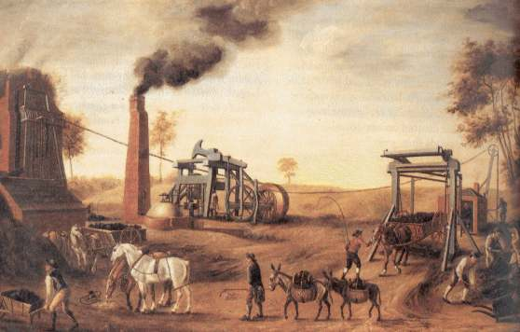
Wage Labor
“England were at least partly dependent on wage labor. This meant people had money to buy such goods and market relationships were becoming more important in their daily lives. With the growth of wage labor came the first stirrings of class organization” (Fulcher, 21).
A depiction of laborers in 18th century England
Notes:
“At the end of the 15th century, merchant capitalists reorganized mining in northern and central Europe” (26). The Fuggers (merchants) made their fortune from trade and loans to the Hapsburg Empire (fuedalism) but increased by investing in mining operations in Hungary and Austria. They employed hundreds of workers and made huge profits. “It was in the mines of central Europe that the previously independent miners became wage labor, and the work arbeiter, German for worker, first came to use at this time” (26).
Apart from

Slide 8
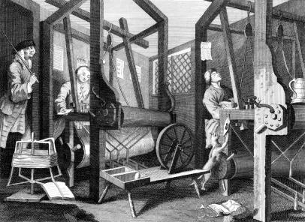
Organizing Wage Labor
Wage labor was organized in a number of ways:
Silent monitors as a reminder of quality of work
Curfews
Fines for drunkenness
Depiction of a mill in 18th century England

Slide 9
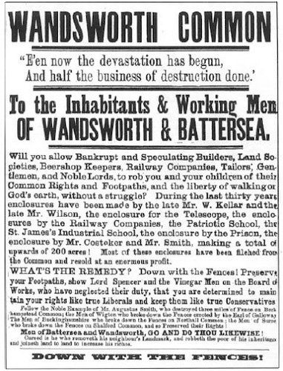
Enclosure Movement
As social classes and wage laborers were organized, England formerly enforced laws to fence off public land.
This turned what had been common land available to all into private property, and forced local people off the land who had relied on their right to exploit common land.
Allowed for more organized, manageable units for owners.
Notes:
https://ctlsites.uga.edu/whatthehistory/author/mms63994/

Slide 10
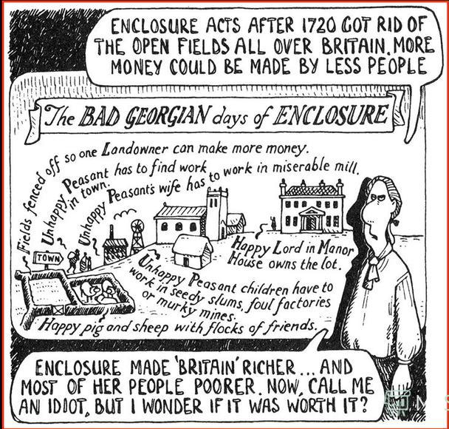
Notes:
“Feudalism had the potential to evolve into capitalism but whether it did so or not depended on other factors” (33).
Under feudalism, power and wealth were linked to the control of land not the ownership of capital
A transition to a market economy could also be made relatively easily. Peasants’ obligations to provide labor services or produce for the lord could be replaced by money payments, which in turn meant that peasants had to earn money through wage labor or the sale of produce in markets” (32-33).

Slide 11
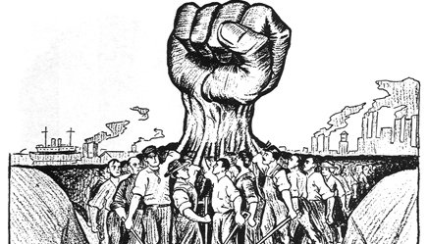
The Owner Class
The Working Class
Owns the machinery, factories, land, and most importantly, the money to help produce capital
The people who use capital to produce goods and have no ownership of that capital.

Slide 12
The Creation of ‘Leisure’
Time became a “battleground” between workers and owners (7).
Wage workers had money to spend in their time off, creating commercialized leisure through individualism.
Created new industries that fed right back into capitalism.
Notes:
“all involve the investment of money in order to make a profit, the essential feature of capitalism. It is not the nature of the activity itself that matters but the possibility go making a profit out of it. Indeed, it is typical of a capitalist society that virtually all economic activities that go on thin it are driven by the opportunity to make a profit out of capital invested in them”

Slide 13
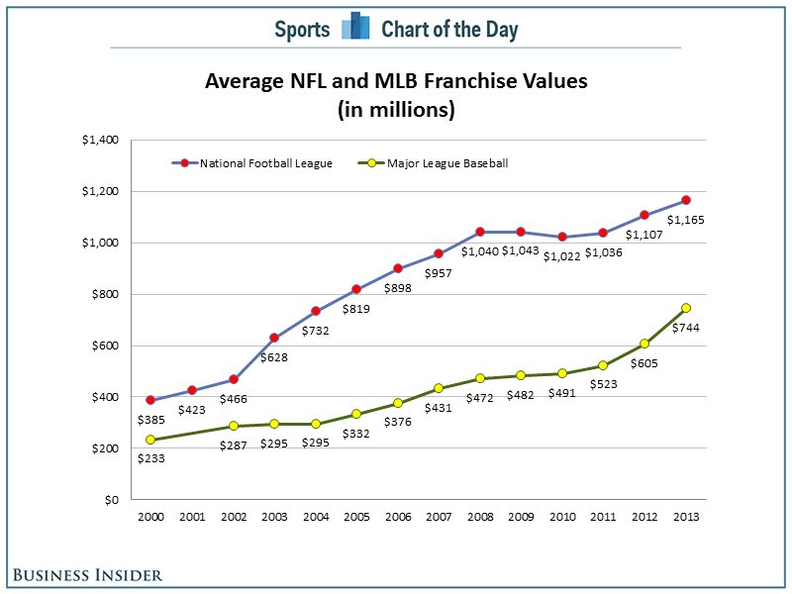
Sports Ownership and Capitalism
In the modern day, leisure activities have remained profitable endeavors for investors.
Sports franchises’ values have grown steadily in the 21st century.

Slide 14
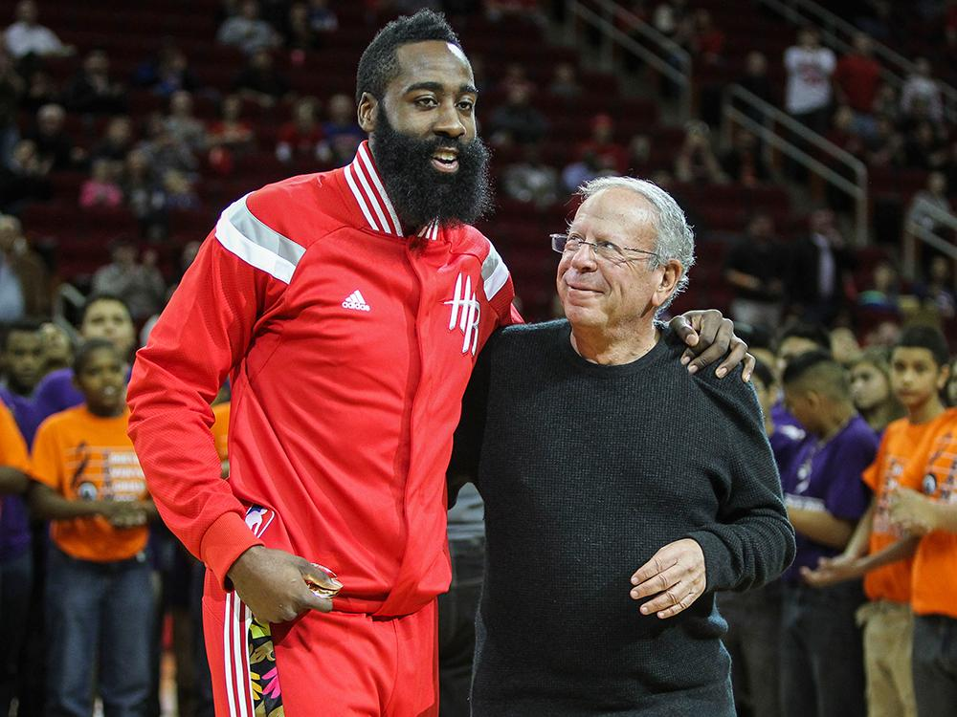
Leisure, Ownership, and Capitalism
In the 1994-1994 season, Leslie Alexander purchased the Houston Rockets for $85 million.
In 2017, the Rockets sold for $2.2 billion.
Leslie Alexander pictured with James Harden

Slide 15
In a capitalist economic system, the owner of production is the individual, and the benefactors of production are first the individual and second the society.
Unlike socialism, communism or fascism, there was no role for government in the economy, so there was a lack of rules regulating working hours, wage, or child labor laws. Karl Marx defined the workers as “wage slaves” (14).

Slide 16
The Birth of Unions
Competition forces companies to constantly compete in many different ways by trying to find new ways to efficiently exploit labour. To avoid paying the best workers, companies would often avoid paying skilled workers to keep their prices down (15).
Starting in 1424 Journeymen workers started to strike for better wages. Without the working class, the owner class could not succeed. This was one of the first examples of workers forming a union to stand up to ownership.
The issue was that only the unions with skilled workers could survive because they could control entry into their craft (39).

Slide 17
Stages of Capitalism
Anarchic capitalism- 18th to early 19th century
Managed capitalism-mid-19th century to 1970s
Neoliberalism-1980s to present day

Slide 18
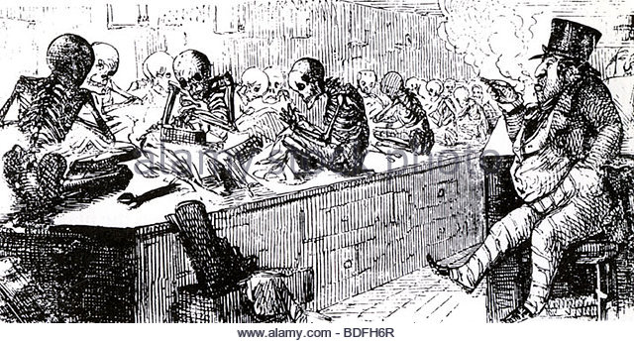
Anarchic Capitalism
“Competitive small-scale manufacturing, a weak labor organization, economic deregulation, a strong state, and minimal state welfare were the mutually reinforcing features of this stage in the development of capitalism” (41).
Entrepreneurs were mostly unchecked by labor.
Depiction of a Victorian Factory in 19th century England. Pictorial Press Ltd / Alamy Stock Photo.

Slide 19
Managed Capitalism
While unions helped the worker class to an extent, the workers, specifically the unskilled needed more help surviving in the capitalist world.
In the 1800’s the state started to regulate such things as working conditions, hours, and child laws. (Health and Morals of Apprentices Act & Factory Act)
Employers came together to counter the growing industrial power of the workers and the unions. Soon, managers started to oversee day-to-day operations instead of shareholders

Slide 20
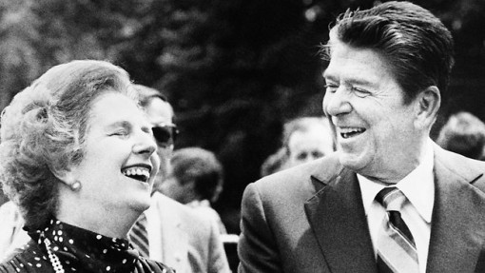
Neoliberalism-Modern Day Capitalism
Rolling back of the state. Two thirds of state owned industries were sold in 1992 (49).
State uses police to defeat coal miners strike in 1984, one of many ways in which unions were thwarted and struck down in the 1980s.
Central government took over much of local government and privatized local government services.
Ronald Reagan and Margaret Thatcher, instrumental in neoliberal policy.

Slide 21
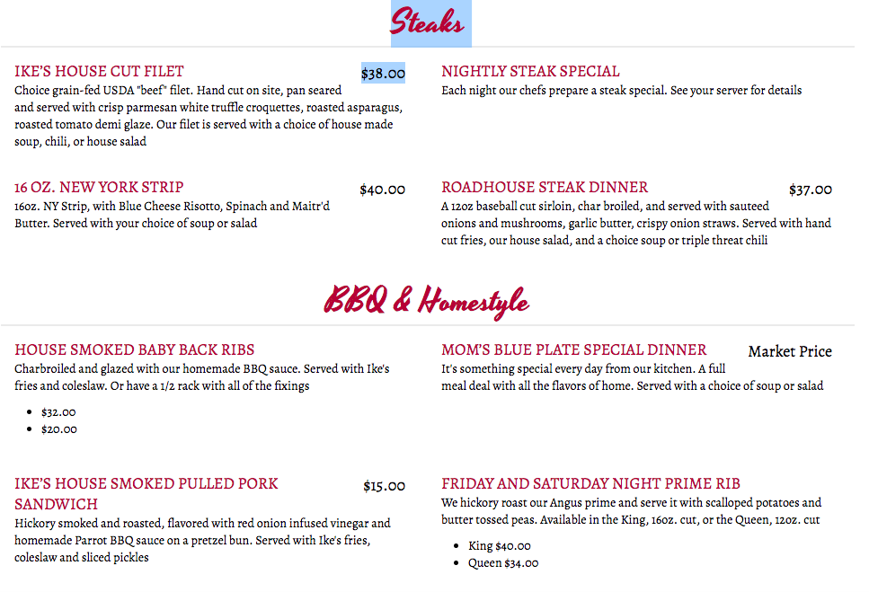

Slide 22
