Slide 1
The Power of Gender Bias
In Sports Casting and Reporting
By Christian LaMonica

Slide 2
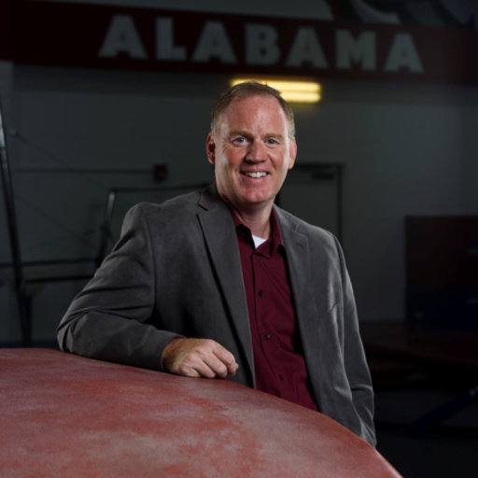
Brief Summary
Who?
Susan Tyler Eastman
Andrew C. Billings

Slide 3
Brief Summary Cont.
What?
Men athletes and men's sports will occupy more than three quarters of time and space in both the electronic and print media.
The newspapers will give a significantly larger proportion of their space to women athletes and women's events than the electronic newscasts allot of their time.
Both electronic sportscasts and the newspaper sports pages will reflect significantly increased visibility for women athletes and women's sports during the periods when major women's sports events are occurring.
Because women's sports have a novelty aspect and because USA Today appeals to both a female and male readership, that newspaper will have a significantly greater proportion of stories about women athletes and women's sports than the more conservative New York Times.
In sports discourse, women athletes and women's sports will be significantly more stereotyped in negative ways than men athletes and men's sports.
Because of their different target audiences, announcers for ESPN's SportsCenter will use significantly more stereotypical descriptors that marginalize women athletes and women's sports while inflating the importance of men's sports than announcers on CNN's Sports Tonight.

Slide 4
Brief Summary Cont.
When?
May-September of 1998

Slide 5
Brief Summary Cont.
Why?

Slide 6
Brief Summary Cont.
How?

Slide 7
The 6 Hypotheses and Conclusions
Men athletes and men's sports will occupy more than three quarters of time and space in both the electronic and print media.
The newspapers will give a significantly larger proportion of their space to women athletes and women's events than the electronic newscasts.
Both electronic sportscasts and the newspaper sports pages will reflect significantly increased visibility for women athletes and women's sports during the periods when major women's sports events are occurring.
Because women's sports have a novelty aspect and because USA Today appeals to both a female and male readership, that newspaper will have a significantly greater proportion of stories about women athletes and women's sports than the more conservative New York Times.
In discourse, women athletes and women's sports will be significantly more stereotyped in negative ways than men athletes and men's sports.
Because of their different target audiences, announcers for ESPN's SportsCenter will use significantly more stereotypical descriptors that marginalize women athletes and women's sports while inflating the importance of men's sports than announcers on CNN's Sports Tonight.

Slide 8
Numbers not from the 1900s
2024 Olympics will be first with 50/50 coverage
48.8% in Tokyo 2020, and 45.6% in Rio 2016
Mixed gender events have grown from 18 to 22
28 out of 32 events will be fully gender equal
100% Gender equality (In athlete quotas)

Slide 9
How to start Fixing this Problem

Slide 10
Citations
Cowley, Emma, et al. “‘Invisible Sportswomen 2.0’—Digging Deeper Into Gender Bias in Sport and Exercise Science Research: Author Gender, Editorial Board Gender, and Research Quality.” *Women in Sport and Physical Activity Journal*, vol. 32, no. 1, Jan. 2023, doi:10.1123/wspaj.2023-0039.
Chakradhar, Shraddha. “Are Readers’ Biases to Blame for Gender Disparities in Sports Reporting? This Study Says No.” STAT, 25 Jan. 2022, 2:05 p.m., https://www.niemanlab.org/2022/01/are-readers-biases-to-blame-for-gender-disparities-in-sports-reporting-this-study-says-no/
"Gender Equality and Youth at the Heart of the Paris 2024 Olympic Sports Programme." IOC News, International Olympic Committee, 7 Dec. 2020, https://olympics.com/en/news/gender-equality-and-youth-at-the-heart-of-the-paris-2024-olympic-sports-programme

