Slide 1
Investigating nonprofits
JRN275
Quinnipiac University
Fall 2019
Dr. Molly Yanity

Slide 2
Why Investigate Nonprofits?
Private, but have agreement with IRS
Do *you* want your donation to the animal shelter going toward a pool party for its leadership?
Hale House and grant money: link

Slide 3
Case Study
So a kid falls off a carnival ride
Lawyer says he’s maimed for life and they’re suing
You see the kid playing outside
Do you:
Talk to the kid?
Write that a lawsuit is planned?
Neither?

Slide 4
Case Study
You hold off, but learn the name of the nonprofit that hosts the carnival and the private company running it
You also visit the final day and observe police allowing underage drinking
Do you:
Write that police were allowing underage drinking?
Keep digging?

Slide 5
Case Study
You obtain the nonprofit’s 990 and also call other towns where this company has run a carnival
You learn the charities make hardly any money, and see questionable numbers on the nonprofit’s form
Do you:
Write that the big annual fundraiser hardly raises any money?
Keep digging?

Slide 6
Case Study
The non-profit president miraculously confirms that his group spent $5,000 on a pool party, and that scholarships are going to members’ children
Do you:
Write that non-profit donated $872 to charity while spending tens of thousands on its members?
But wait, what about the kid who fell off the coaster?

Slide 7
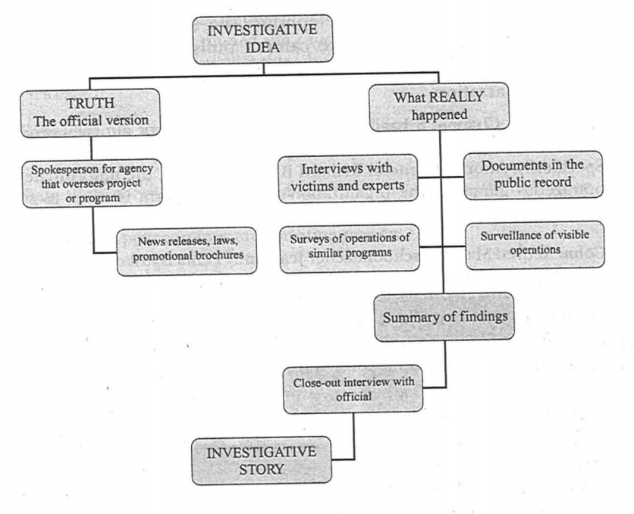
Charting

Slide 8
Your Turn – Find A Story!
Not-for-profit Organizations
IRS 990 forms – includes key officers, salaries, contact information as well as the organization’s financial statements. It also includes essential information on finances, assets, investments and expenditures, staffing changes over time and sub-organizations. The footnotes can help generate story ideas.
Charitable purpose annual reports
ProPublica’s NonProfit Finder
Foundation Center’s 990 Finder

