Slide 1
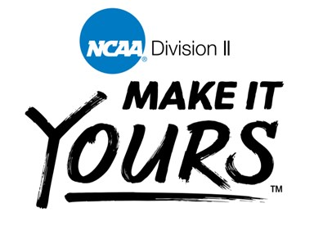
The NCAA and College Sports
By: Megan Maharry

Slide 2
Overlook
NCAA : National Collegiate Athletic Association
Divisions I, II and III
NCAA brought in over $1 billion in 2017
Biggest money maker is March Madness
Student-athletes got none of that money
NCAA profits off student-athletes’ name, image and likeness, but doesn’t allow the student-athlete to do the same

Slide 3
NCAA Bylaw 12.5.2.1: After becoming a student-athlete, an individual shall not be eligible for participation in intercollegiate athletics if the individual: (a) Accepts any remuneration for or permits the use of his or her name or picture to advertise, recommend or promote directly the sale or use of a commercial product or service of any kind; or (b) Receives remuneration for endorsing a commercial product or service through the individual’s use of such product or service.
NCAA Bylaw 12.5.1.1.1 (Promotions Involving NCAA Championships, Events, Activities or Programs): The NCAA [or a third party acting on behalf of the NCAA (e.g., host institution, conference, local organizing committee)] may use the name or picture of an enrolled student-athlete to generally promote NCAA championships or other NCAA events, activities or programs.
Student-Athlete Statement (Form 12-3a): You authorize the NCAA [or a third party acting on behalf of the NCAA (e.g., host institution, conference, local organizing committee)] to use your name or picture to generally promote NCAA championships or other NCAA events, activities or programs.

Slide 4
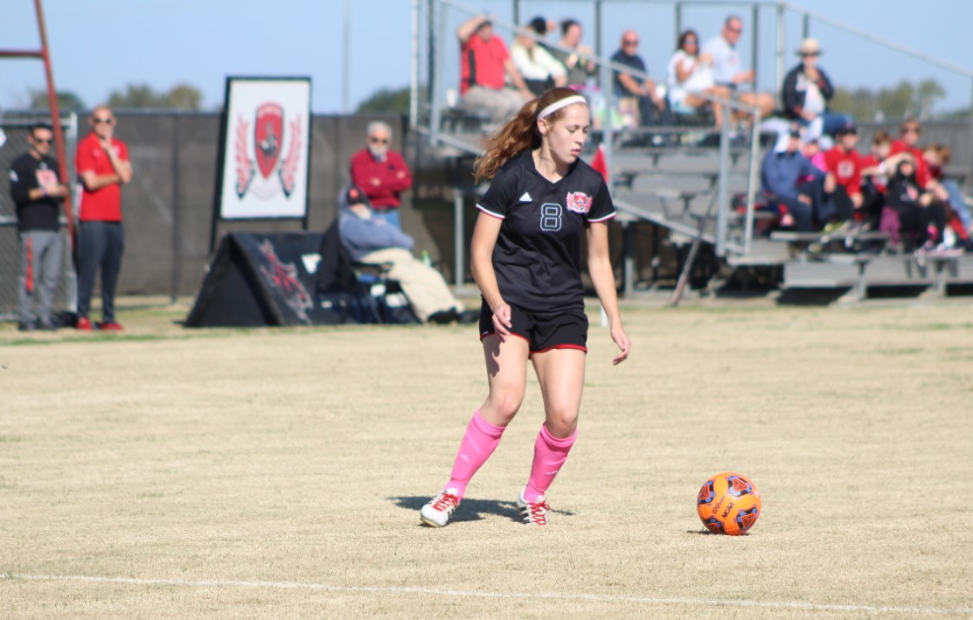
My experience
Played NCAA Division II soccer for Northwestern Oklahoma State University
When I signed, had to declare “amateurism”:
Forfeited my ability to profit off my name, image, and likeness
Also can’t accept money, gifts or any form of compensation if not offered to the rest of regular student population

Slide 5
The $10 billion sports tab
Average attendance last year was among 10 worst in the NCAA’s top level. Yet Georgia State’s 32,000 students are still required to cover much of the cost. Over the past 5 years, students have paid nearly $90 million in mandatory athletic fees
In the past five years, public universities pumped more than $10.3 billion in mandatory student fees and other subsidies into their sports programs
Student fees to support athletics = elite athletic programs = destination campuses
Subsidy rates tend to be the highest at colleges where ticket sales and other revenue are the lowest—meaning students who have the least interest in their college’s sports teams are often required to pay the most to support them

Slide 6
Forbes’ College Football’s Most Valuable Teams
(Based $ average from past 3 season)
https://www.forbes.com/sites/chrissmith/2019/09/12/college-football-most-valuable-clemson-texas-am/#50f29998a2e7

Slide 7
Student-athletes earned $0

Slide 8
The Shame of College Sports
Scandals:
USC and Reggie Bush
Auburn and Cam Newton
Coach Jim Tressel and Ohio State
The real scandal is not that students are getting illegally paid or recruited, it’s that two of the noble principles on which the NCAA justifies its existence—amateurism and the student-athlete—are cynical hoaxes, legalistic confections propagated by the universities so they can exploit the skills and fame of young athletes
Paid athletes would destroy the integrity and appeal of college sports
Slavery analogy should be used carefully—college athletes are not slaves
Myth of Student-Athlete
Academics

Slide 9
There’s nothing we can do
We must admit that:
Amateurism doesn’t work and never will, except as a model for those who are not serious athletes or for whom the sport is simply a pastime
We love watching our favorite sports teams win and not just compete
Being paid for a sport is not wrong, regardless of the age or educational background of the athlete
Create Age Group Professional Football League (AGPLF)
Set up reasonable pay
Still represent university with team colors and mascot; colleges cannot charge admission to games or use teams as money makers
College football season shorter
Overall—AGPLF gives elite athletes chance to make money and play more games; college football teams give student-athletes a chance to play while also having a fair chance at a good academic education

Slide 10
Changes to come
In October of 2019, the NCAA announced students would be allowed to profit off their name, image and likeness pending rules and guidelines put into place by the divisions.
Chair of the NCAA board Michael Drake said: “We must embrace change to provide the best possible experience for college athletes.”
Between now and 2021, Divisions I, II and III will set rules.
However, this all came about only because California announced in September they would allow their student-athletes to be paid.

Slide 11
Sources
https://www.cnn.com/2019/10/29/us/ncaa-athletes-compensation/index.html
https://www.businessinsider.com/ncaa-college-athletes-march-madness-basketball-football-sports-not-paid-2019-3
https://www.npr.org/2019/09/30/765700141/california-governor-signs-bill-allowing-college-athletes-to-profit-from-endorsem
https://law.marquette.edu/assets/sports-law/NCAABylaws.pdf
https://www.forbes.com/sites/chrissmith/2019/09/12/college-football-most-valuable-clemson-texas-am/#3fd3423aa2e7
https://sports.usatoday.com/ncaa/salaries/

