Slide 1
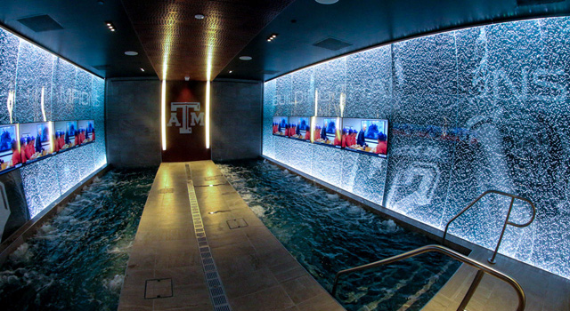
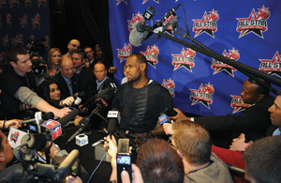
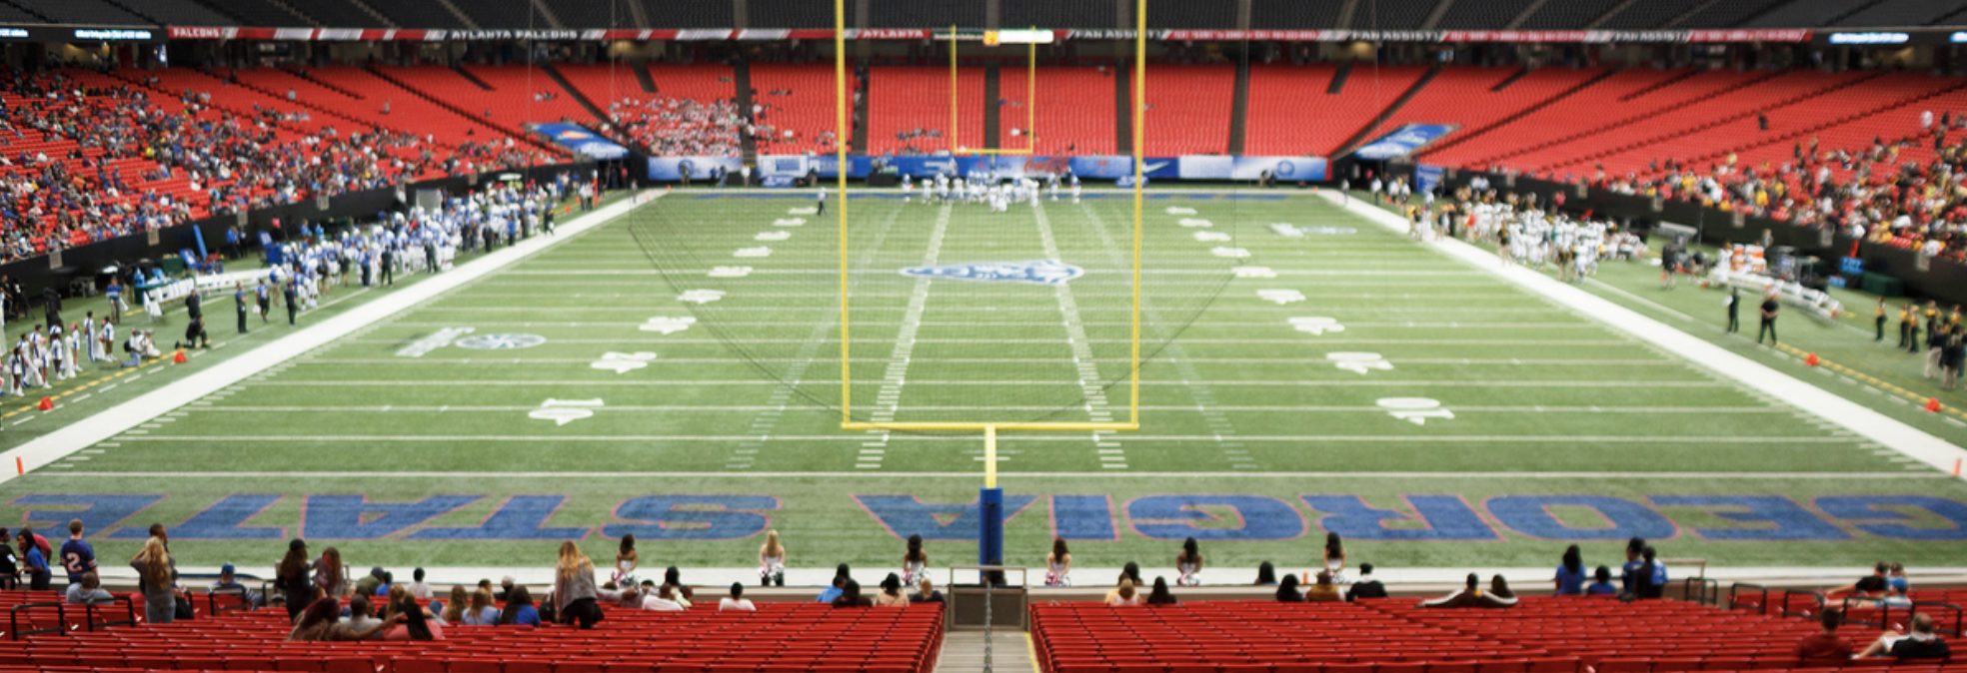
The Sports Media Complex, Part I
Robyn Brown
February 12, 2018

Slide 2
Cultural Studies & the Sports Media Complex
In 1987, the leading voice of the American Left decided to go against two major platforms
Sports were chosen over political, economic, and social events – precedent to sports coverage

Slide 3
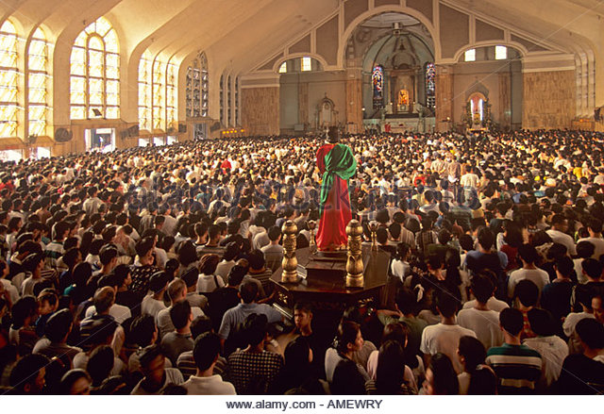
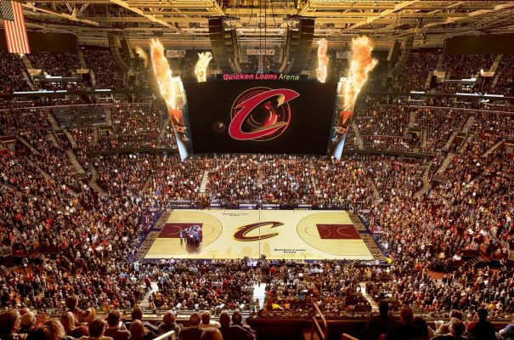
Marx Beliefs & Gary Whannel
Gary Whannel wondered if the same type of energy that was directed toward sports could be placed toward political activity, the type of societal advancements that could be made
Merely a fantasy
Decided to take this concept of sports spectating and broke it down into two major categories:
1. Ritual and Ideology 2. Compensatory Fulfillment

Slide 4
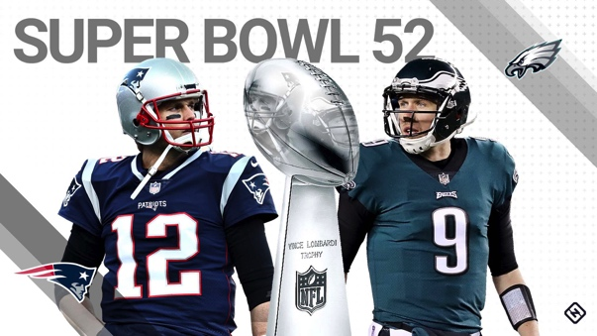
Ritual and Ideology
Argument: Due to the capitalism sphere, workers are unable to see the reality of their exploitation
Communal celebration
Use of propaganda (emotions, life style, values)
Beyond mere entertainment
Social structure

Slide 5
Compensatory Fulfillment
Catering to the “new cultural-emotional needs of the masses”
Sports offer excitement that is denied to corporate society
Two ends of the spectrum of emotional gratification

Slide 6
The New Direction: Cultural Studies
Richard Johnson stressed the following three premises for critical cultural studies:
1. Cultural processes are intimately connected with social relations
2. Culture involves power
3. Culture is neither self-governing nor a determined field, but a site of social differences and struggles
Notes:
Culture is defined differently by everyone. Takes into account the historical forms of consciousness and subjectivity

Slide 7
Consciousness v. Subjectivity
Consciousness: refers to the way in which we cognitively make sense of the world (the knowledge we have of it and how it works)
Subjectivity: refers to the absence of consciousness, the possibility that things move us just because
Sports therefore offer a mapping of the world. People form connections to a particular time and place. It is a phenomenon.
Notes:
These are emotions that are often unable to be explained sometimes. It is a phenomenonbetween the way of life and the structuring of feelings

Slide 8
Cultural Studies, the Media and Cultural Commodities
Introducing the sports media complex:
) Most people consume the vast majority of their sports spectating via the media
B. ) Financial point of view – professional and now collegiate, sports are dependent upon media money for their survival
Notes:
This is presented to us in two fundamental ways
a. Through televisin mainly aka your cultural experience is being hugely facilitated

Slide 9
Models of Media Analysis
Encoding/Decoding Model
Production, circulation, distribution/consumption, reproduction
Circuit of Culture Model
Focus on the production of cultural products
Focus on the texts that are produced
Focus on how these texts are read by ordinary people
Focus on lived cultures and social relations that relate to the uses made of the reading of texts, as being materials that new forms of cultural production can draw upon

Slide 10
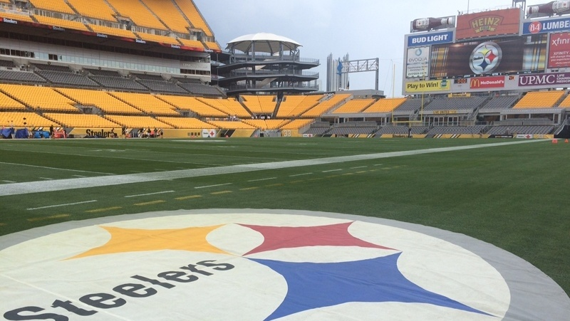
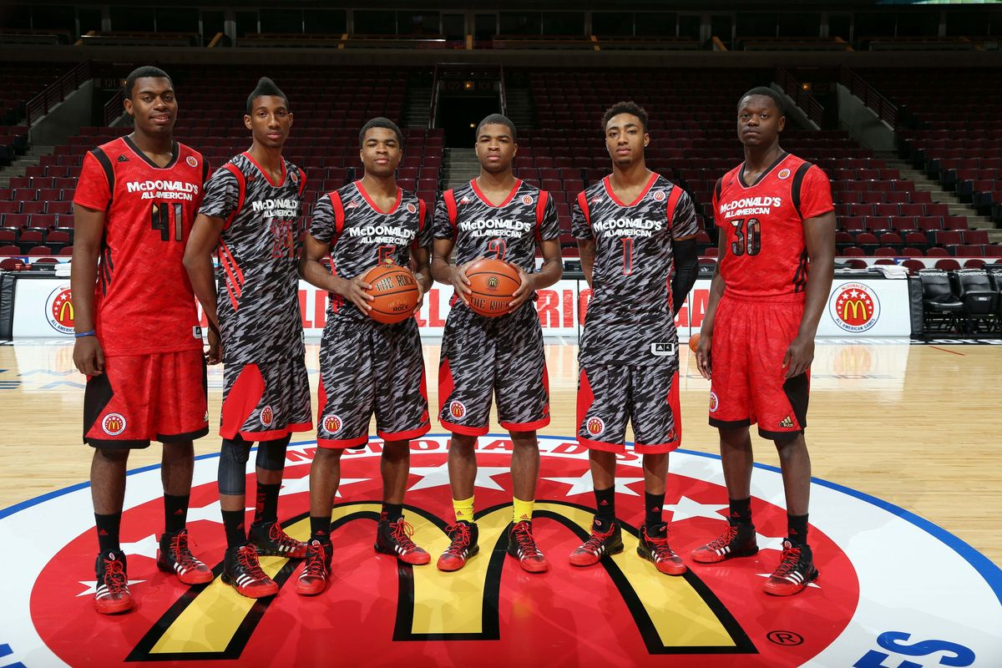
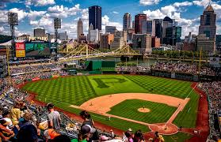
Breaking down the Production
For every team, there is a commodity that can be identified
Example: Corporations directly sponsor teams and events in hopes of attaching their names to the meaning of the particular activities

Slide 11
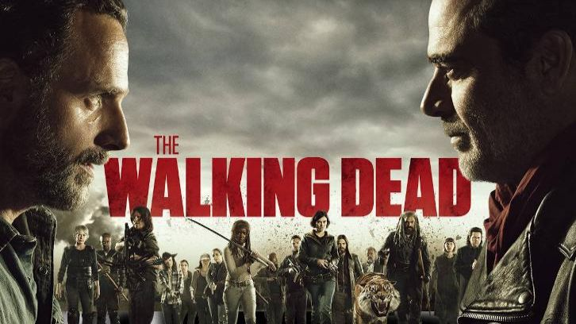
Addition to Direct Sponsorship
Purchase of advertising time during sports programming
Notes:
Not only do sports programs generate a great deal of revenue for the media, but the media can also advertise their own upcoming programs to thus increase ratings and revenue for non-sports programming

Slide 12
Argument at Hand
Have professional sports transformed from being pure to becoming lost in commercialization?
According to the article, they have always been based on commercial relations. This is because they depend on two kinds of commodity sales
1. Sell tickets to fans who come to see the live event | 2. Professional sports sell the rights to broadcast events to the media
Notes:
so people say that the media now has taken away the pureness of sport. But as you can see, they have always been influenced through a commodity sphere.

Slide 13
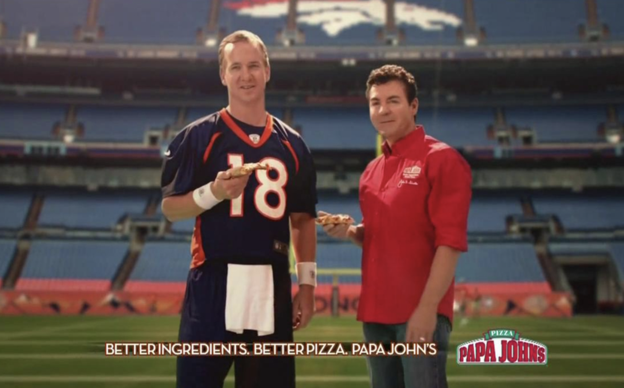
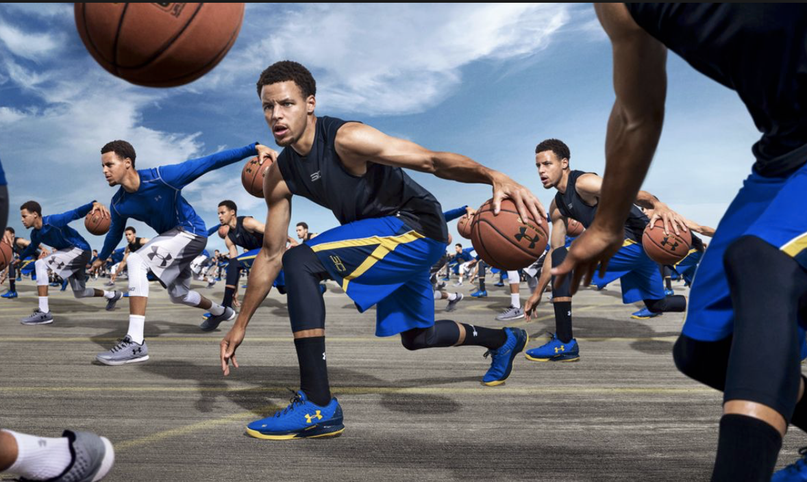
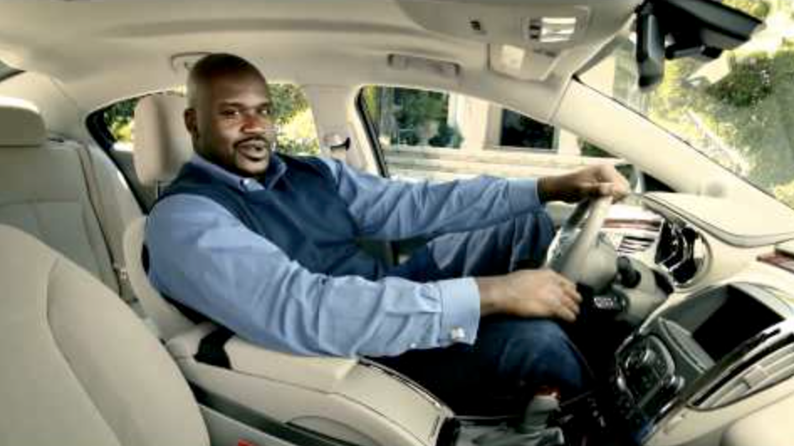
Player Commodity
Notes:
Players obtain revenue directly from manufactures by players endorsing their products. They can therefore use this celebrity even after their playing days are over.

Slide 14
Role of the state
Although a state itself is not directly involved in the production and sale of commodities, it defines the conditions within which the other activities take place
Provides an exemption from antitrust legislation
Advertising expenses are tax deductible as business expenses
A state can impose or lift restrictions on certain products
Notes:
The last part in understanding the commodity structure s the state
2nd bullet means that they are exempt for sports leagues in their negotiation with television networks
- This has led to leagueschanging rules of the game for better tv packages, clubs have moved to different cities

Slide 15
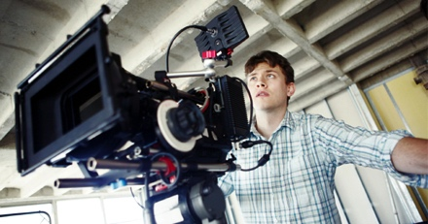
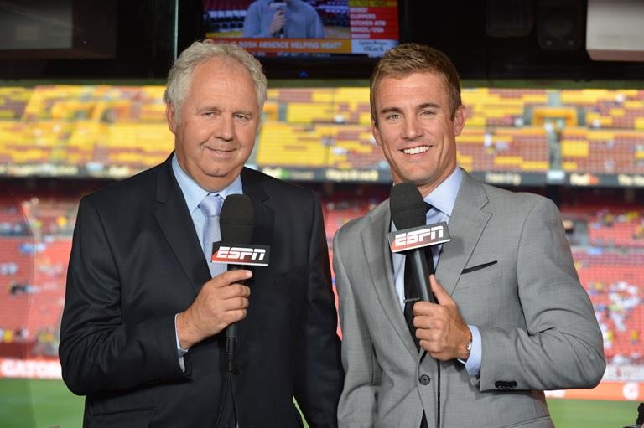
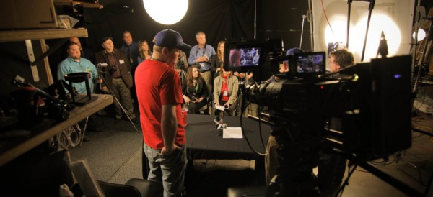
Production: Encoding the Message
Simple but vital: Television does not present us with a sports event that is mediated
A game is live and unscripted
But television is forced to provide its own structure and ideological viewpoints
How do they do this?

Slide 16
Television Sports Production - Four
Hierarchization: the process of signaling that some things are more important than others
Personalization: the presentation of events from an individualized perspective
Narrative: the telling of events in the form of stories
The placing of events in the context of frames of reference

Slide 17
The Texts of Mediated Sport
There is no natural meaning of sport
The meaning of mediated sport is the outcome of a technical, economic, cultural, political, and social factors. This is not accidental
Major Tenets:
Militarism and Nationalism
Competition and the Rules of the Game
Labor, the Team, and Authority
Gender
Race
Readers and Decoding
Lived Cultures and Social Relations

Slide 18
Tenets
Militarism and Nationalism
Most sports telecasts start with the presentation of the flag or fighter airplanes flying while the star-spangled banner is being sung
Specific commentary – one would think our society had such a strong emphasis on the military
Ex. “the aerial attack”, “advancing into enemy territory”, “the bullet pass
“we” are separated from “them”

Slide 19
Tenets
Competition and the Rules of the Game
At the heart of all sports is the rules of the game are clear and neutral
Labor, the Team, and Authority
Media transforms authority figures such as coaches and managers that are exploitative into ones that can be identified as personal
Owners caring

Slide 20
Tenets
Gender
Every society differentiates along lines of sex. It is a biological identifier. However, social understanding has different meanings
How do mediated sports define notions of masculinity? Feminity?
Race
Most visible arena for racial minorities
“Black players act as powerful role models for black youngsters”
Magic Johnson v. Larry Bird – work ethic

Slide 21
Tenets
Readers and Decoding
Everyone interprets messages differently
Bourgeoisie – re-election of existing relations
Others – Realm of escape, where justice actually appears to prevail
“Sports can both provide an escape from a particular social condition and be a powerful form of socialization back into those same conditions”

Slide 22
Tenets
Lived Cultures and Social Relations
There is a class basis to cultural consumption
Although a coherent working class no longer exists, images are presented on TV disguised though cop shows and camaraderie associated with beer commercials
Often sports have been known as a sanctuary for men, an exclusive male manner

Slide 23
The $10 Billion Sports Tab
Georgia State – Season 2013-2014 (1 win) (3-29)
32,000 students are required to pay mandatory athletic fees to support intercollegiate athletics (increase)
A river of cash flowing, coaches salaries - only to handful of elite programs
In 2014, athletic fees totaled $17.6 million
“In America and especially in sports, you’re not allowed an intelligent timeline. You’ve got to take one that launches you so you’re on ESPN’s Game Day sooner”

Slide 24
The community around them want to see success in their sports departments
University of Alabama at Birmingham announced their plan of dropping football ($20-million budget shortfall
Public outcry
Misconception that school’s will not receive applications
Divided about whether students should pay fees to support their college teams – without that money certain sports or scholarships might not be offered
Awareness (40% did not know)

Slide 25
Georgia State Football
Earmarked: Less than $70,000
Spent: $4.2 million
If there is not donor support or revenue gain due to being unsuccessful on the field. How do you drive in money without creating more of a financial burden on students through fees?

Slide 26
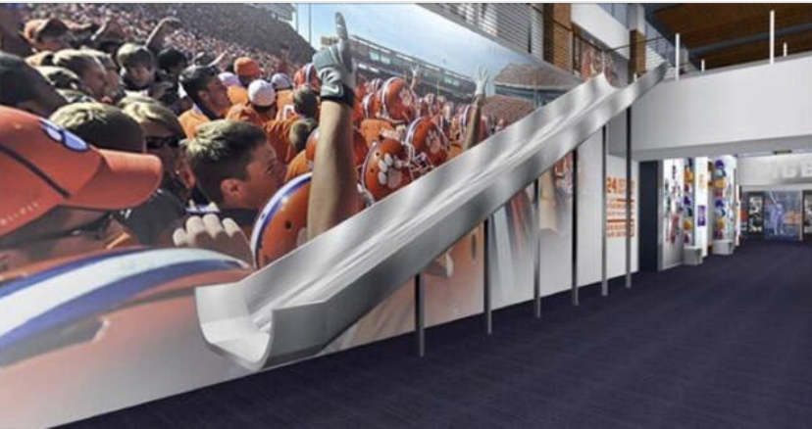
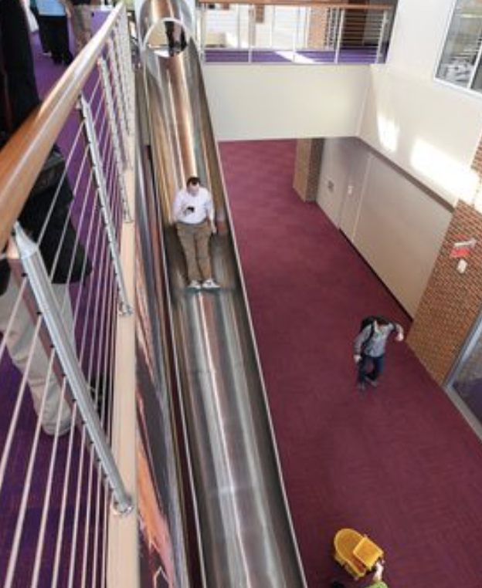

Slide 27
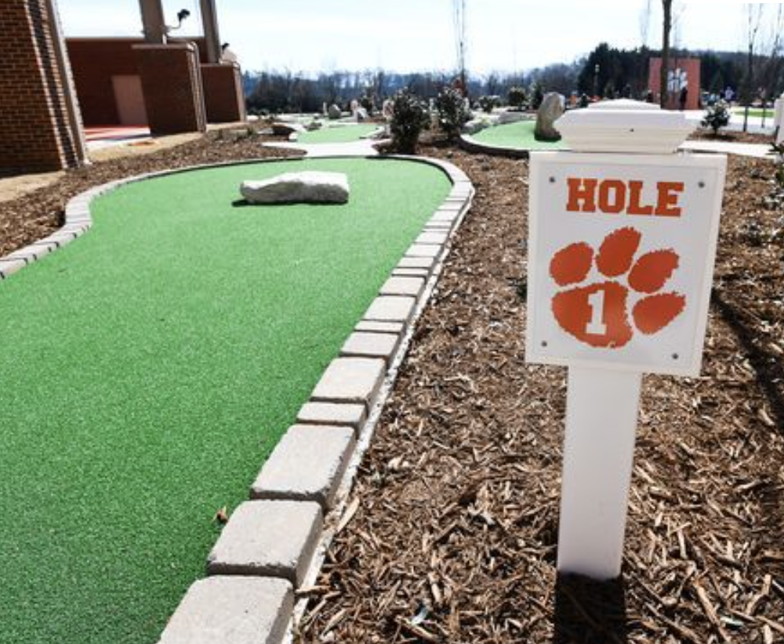
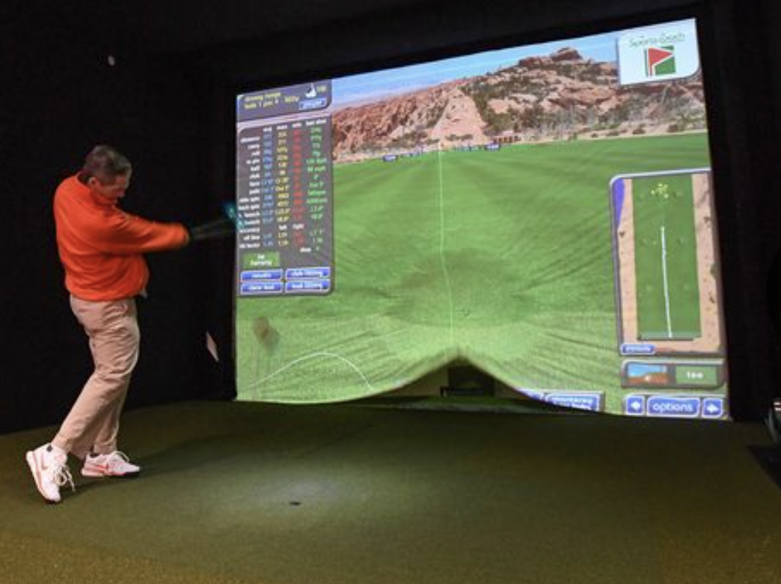
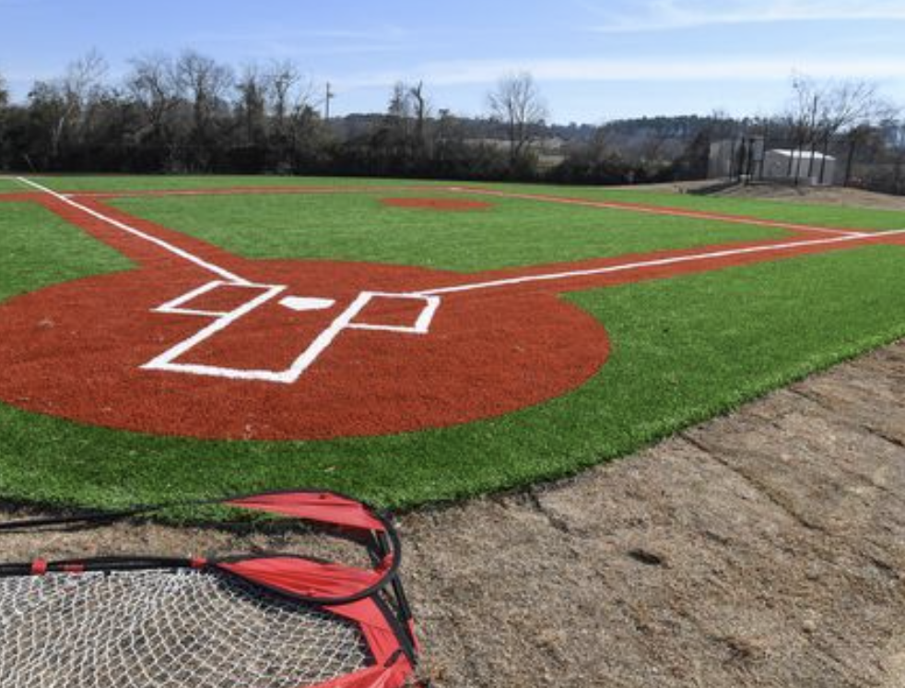

Slide 28
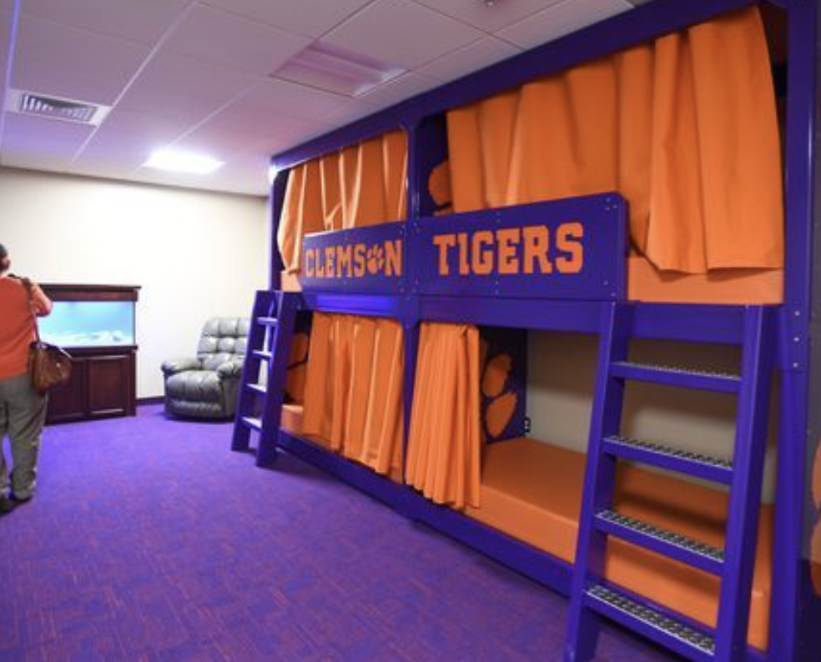
https://www.youtube.com/watch?time_continue=115&v=pXjpUSOxIBw

Slide 29
