Slide 1
The Sports Media Complex
Part II
By Camila Costa and Dan Walker

Slide 2
Sports Media: A Modern Institution
Sports broadcast (baseball and boxing) were used to market television sets in the 1950s
Today, they are a major selling point for HDTV receivers
All-sports media vs. news of the day
Sports and media – different institution?
Sports as a way to attract young readers to news outlets/magazines
“Guy talk” – do you think there is still this concept that sports are for guys? Do you think this has changed throughout the years?

Slide 3
Rise of “Big Time” Spectator Sport
“Sports as most individuals conceive them today are defined as something that you watch, listen to, read about, and talk about rather than something you do.”
Why do we watch sports?
What is the role of the spectator?
How has electronic media changed the role of the spectator?
Is sports coverage less controversial than political economic issues?

Slide 4
Broadcasting and Sport
Sports are a major selling factor
Close relationship between beer and sports – how many of us associate beer with sports?
Coors Light Commercial
Sports Broadcasting Act of 1961 (SBA)
Allows professional sports teams to pool and sell their rights for games to television networks

Slide 5
Why Are Sports Necessary To The Continuing Growth of Television
The Reality Factor
The Regularly-Scheduled and Cost-Effective Factors
The International Literacy Factor
The Benign Viewer Factor
The Loyalty and Effects Factor
The Zap-Proof Factor
The Promotion Factor
The Integration Factor

Slide 6
The Reality Factor
“Sporting events typically are presented live with the attendant element of real-time suspense.”
Outcome cannot be predicted

Slide 7
2. The Regularly-Scheduled and Cost-Effective Factors
“Unlike other “live” events, sports are regularly scheduled and continuing like other entertainment series, which makes them cost effective compared to many other forms of programming.”
Sports provide television with hours and hours of regularly scheduled live programming
Sports fill a lot of time
Cost efficient for television outlets

Slide 8
3. The International Literacy Factor
“There are minimal barriers of language and literacy for sports viewers.”
Almost everyone can understand the basic point of the game regardless of the language in which it is presented
Action adventure programs and movies
Good versus evil
Right versus wrong
Violent conflict and action

Slide 9
4. The Benign Viewer Factor
“Even those who are not fans have a generally benign attitude toward sport. Very few people are sports haters, especially when viewing in groups.”
Why is it unusual for people to hate sports?
Who we associate with
Constant media attention
Day-to-day communication
Sports bars

Slide 10
5. The Loyalty and Effects Factors
“Sports are culturally ingrained that they can have direct and powerful media effects, such as civic or even national celebration, that most programming cannot. The connection to such celebration and emotion is highly desired by advertisers and programming outlets.”
Men’s Ice Hockey Frozen Four
Super Bowl - Eagles

Slide 11
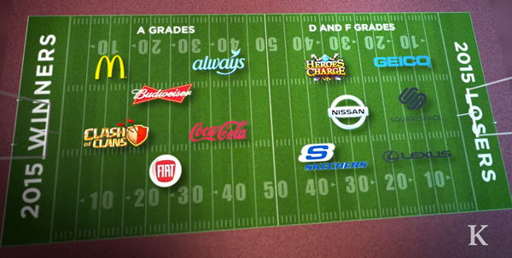
6. The Zap-Proof Factor
“Sports telecasts offer many opportunities for zap-proof advertising.”
Zap-proof = any advertising message integrated with program content
The viewer cannot avoid advertising messages without missing parts of the event

Slide 12
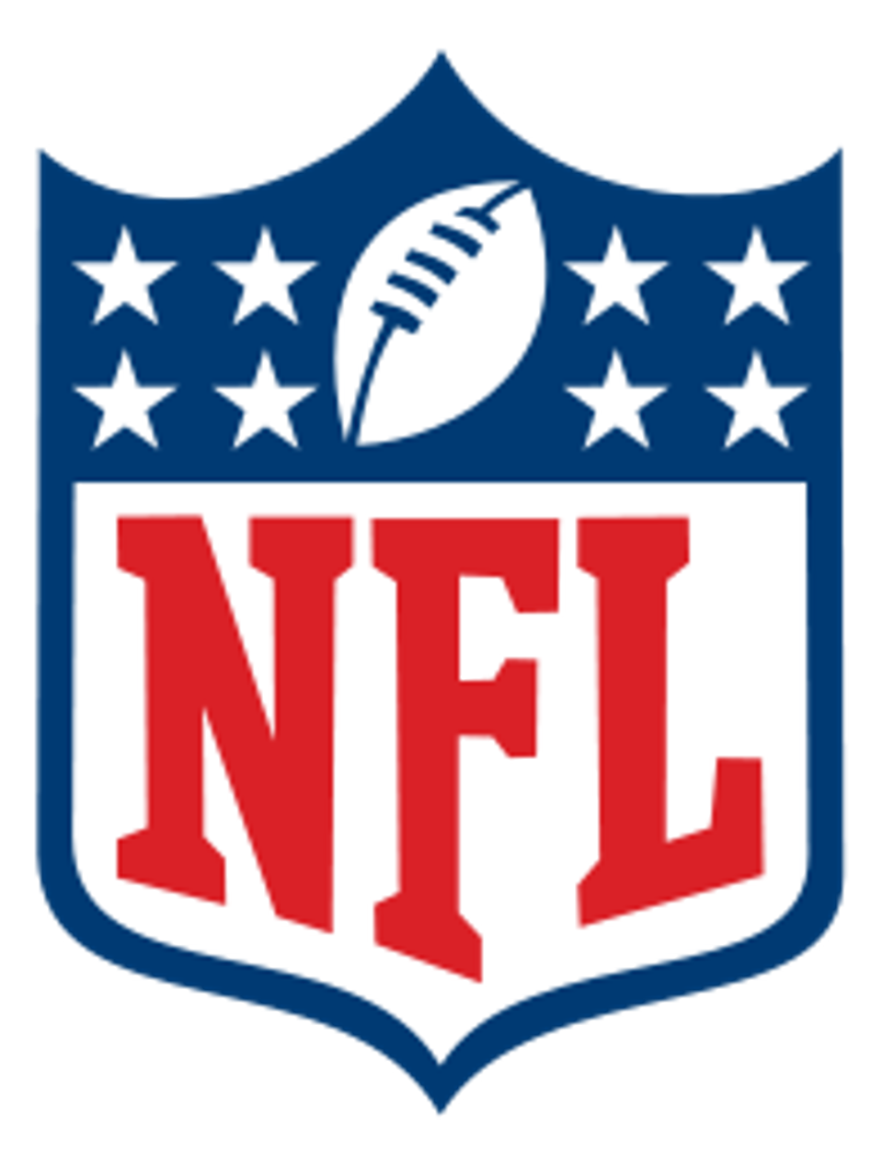
7. The Promotion Factor
“Sports telecasts are widely regarded as an excellent forum for effective promotion of other television promotions.”
Sports telecasts constantly promote other programs on the channel network
Branding
NBC – “The Network of the Olympics”
Fox – NFL, MLB, NASCAR

Slide 13
8. The Integration Factor
“The long-term marriage of television and sports is so well established that the industries are increasingly integrated in effect or in fact. Vertical integration is a key desire and strategy of the major media firms.”
Sports leagues now refer to themselves as being in the media business via their partnerships and their own Websites, publications and even TV channels
Vertical integration of media and sports guarantees programming with no costs outside the external exchange of rights fees

Slide 14
Conclusions
New forms of value-added coverage have been developed and implemented to make the sports business-media-outlet-consumer connection stronger
The consumer expects to have whatever content he or she wants whenever and wherever
A consistent, loyal and lucrative audience less able to avoid advertising and promotional messages and tied into an emerging global popular cultural and consumer mainstream is one of enormous value to the media

Slide 15
The Rhetoric of Winning and Losing The American Dream and America's Team
“Sport seems to be an ideal vehicle for understanding the pursuit of the American Dream, because achievement and success are so openly and explicitly emphasised in sport.” -Former President Richard Nixon, 1984
“Winning is second only to breathing” -George
Steinbrenner, 1984
“Every time you win, you’re reborn; When you
lose, you die a little.” -George Allen, 1976
https://www.youtube.com/watch?v=jFP5j1Pw7yM

Slide 16
America’s Dream: The Ideology of Success
At the center of the American value system is the value of success. There are two distinct and opposing formulations of the value of success:
Success as Product: Competitive Achievement
From this view, success is the end result of competitive achievement and is measured by indexes of personal merits.
This form of success is exemplified by individuals and organizations whose energy, inventiveness, and initiative result in benefits for themselves and for others.
Success as Process: Self-Actualization
This vision casts success as a process of self actualization in which one develops and utilizes physical, intellectual, and creative talents to become the best that one may be.

Slide 17
America’s Dream: The Ideology of Success (Continued…)
Success as Product: Competitive Achievement vs. Success as Process: Self-Actualization
Both are used in sports writing
The dominant version has been success as the product of competitive achievement.
The focus shifts from “how you play the game” to the “bottom line” of wins and losses.
https://www.youtube.com/watch?v=ftPBJzZdjjY
“Sport is primarily an intrinsically rewarding form of behavior that involves satisfaction from performing within a structure of rules.”

Slide 18
America’s Team: Where Mamas Hope Their Babies Grow Up to Be Cowboys
When President John F. Kennedy was assassinated in 1963 in Dallas by a drifter from out of state, many people blamed Dallas for this tragedy and labeled the city as violent.
Football helped erase the stigma of the tragedy. Not just football, however: winning football.
“The Cowboys are more than a professional team, they are a social institution”
From 1960 to 1988, the Cowboys become one of the
most successful franchises in football history.
Five phases of the Cowboy’s success and failure over
this 28 year period....

Slide 19
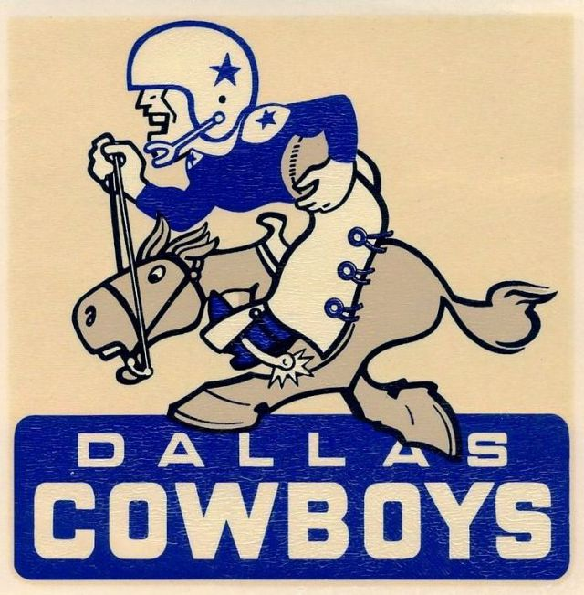
Phase 1: “Beaten But Not Cowed”
The Cowboys were introduced to the league in 1960 and
the team suffered five straight losing seasons (1960-1964).
“In the early years, the Cowboys’ mere survival was
interpreted as success by sportswriters”
Sportswriters affirmed the sense of success as product by recasting losing seasons as qualified successes.
The sense of success as process dominated how writers reported the Dallas Cowboys.
Even though reporters were willing to give this “newborn” team some time to develop a winning team, the product of success was expected in the near future.

Slide 20
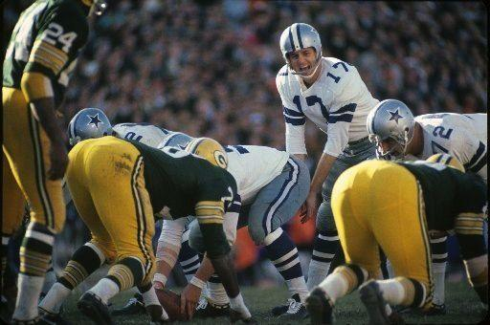
Phase 2: “The Days of Wine and Roses”
Their first non-losing season in 1965 (7-7 record), first winning season in 1966 (10-3-1 record).
“Dallas fans are witnessing the end of an era.”
The Cowboys’ success began to be defined by how much they would win each game by, instead of how the team was improving.
“The won-loss numbers in the NFL standings
are impersonal and bare. They do not tell the
whole story, but they tell the only story that
matters, and they do not lie.”

Slide 21
Phase 3: “Always a Bridesmaid, Never a Bride” &
Phase 4: “Cowboys Look to Dynasty”
1966 is the first of twenty consecutive winning seasons for the Cowboys
There is an evident shift from success as process to success as product in 1967 when the media reported the season as a “failure” and a “disappointment.
The Cowboys won their first Super Bowl in 1971-72, in a resounding victory against the Miami Dolphins.
The next ten years consisted of eight NFC Championship appearances, four Super Bowl appearances, and one Super Bowl victory in 1977.
“There are only three teams in sports that have achieved true national status - The New York Yankees, The Dallas Cowboys, and us.” -Red Auerbach, President of the Boston Celtics Basketball Team

Slide 22
Phase 5: “Didn’t This Used to Be America’s Team?”
By the 1980’s, sportswriters expected the Cowboys to appear in the Super Bowl each year. The years they went 12-4 and 11-5 were deemed unsuccessful if it did not end in a Super Bowl victory.
In 1986, the team had a (7-9) record. This was the first losing season for the Cowboys and a reporter said, “Didn’t this used to be America’s team?” The Cowboys were losing games and sports writers were not happy.
After four consecutive losing seasons, sports writing of the Cowboys had come full circle. Reporters defined Cowboy success as a process rather than as a product.
“Cowboys QB Danny White scrambles in Sunday’s 24-20 loss to the Washington Redskins. But the game, with White involved in a brawl, may have been a moral victory for Dallas.”

Slide 23
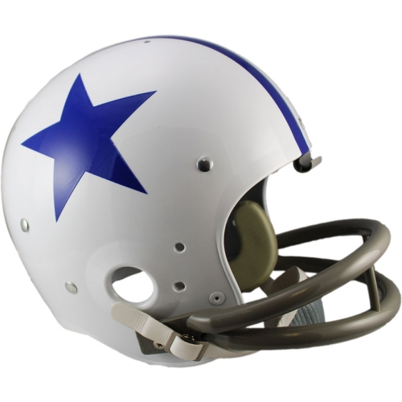
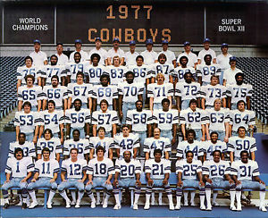
Conclusions
Phase 1: Success by Process
Phase 2: “Winning is the only thing” mentality
Phase 3 & 4: The Cowboys will be victorious forever
Phase 5: Success by Process
“The ideal American Dream is winning
by being one’s best, not winning at all
costs and not losing by being one’s best.”

Slide 24
Rising TV Fees Mean All Viewers Pay to Keep Sports Fan Happy
Time Warner Cable subscribers in Southern California saw an increase in their monthly bills due to an impending $7 billion deal with the LA Dodgers
DirecTV and Verizon FiOS – $2 to $3 monthly surcharge (NY and LA)
ESPN – $5-a-month mark in 2012
LA Times
Sports programming generates $30 billion a year in revenue for TV companies
Broadcast and cable TV executives teed up more than 127,000 hours of sports programming in 2015 – 160% increase from 2005

Slide 25
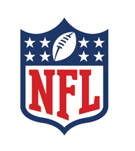
Rising TV Fees Mean All Viewers Pay to Keep Sports Fan Happy (Continued)
NFL
Collects $7.5 billion a year from media companies
$1.9 billion a year from Walt Disney Co.’s ESPN for “Monday Night Football”
$1.5 billion a year from DirecTV for its Sunday Ticket package
$3.7 billion a year from NBC, CBS and Fox

Slide 26
Cable Bill and Sports
Sports make up about 40% of programming costs paid by cable and satellite TV operators
ESPN – $7.20 a month
SportsNet LA – $4.50 a month
NFL Network costs pay TV companies $1.39 a month per subscriber

Slide 27
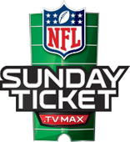
SELECT ALL INCLUDED
$40.00/mo plus taxes
PREMIER ALL INCLUDED
$115.00/mo plus taxes

